Slide 1
CAD/CAM

Slide 2
Key disciplines of modelling in Solidworks
For basic bodies, generate 3D model by taking use of 2D shapes;
Combine basic bodies to create a complex body;
Repeated bodies can be made through array operations;

Slide 3
Coordinate system
By default, there are already a coordinates system provided for user by SOLIDWORKS every time you open a new modelling project. Usually, at the lower-left corner of the canvas, you can notice the symbol of coordinate system with three axes.
Whenever user need to carry on some location or orientation related modelling steps, the coordination system should be considered.
For example, in the scenarios of re-oriented a model or two models comparing user should define his own reference coordinate systems.

Slide 4
Sketch
Plane curves
Two types of Constraint
Dimensional constraints: length and angle
Geometric constraints: parallel, perpendicular, normal, tangent, concentric, etc.

Slide 5
Universal/absolute coordinate system
working coordinate system

Slide 6
References objects
Reference points
Reference vectors/axes
Reference plane

Slide 7
Geometry of curve
Standard mathematic curves
Bezier curves
B-spline curves
Parameterized curves
Wire frame modelling

Slide 8
Geometry of surface
Ruled surfaces
Other standard mathematical surfaces
NURBS
Surface modelling

Slide 9
Constructive solid geometry (CSG)
CSG is one of a fundamental theories of varies 3D modelling CAD system.
Boolean operations of multi-bodies
One of ideas in CSG is that some algebraic calculations can be performed between two bodies.
There are three basic Boolean operations of bodies, which are named unite, difference and intersect, derived from set theory. However, in Solidworks, they are called add, subtract and common, respectively.
Through Boolean operations one can take uses of several bodies to generate a new body.

Slide 10
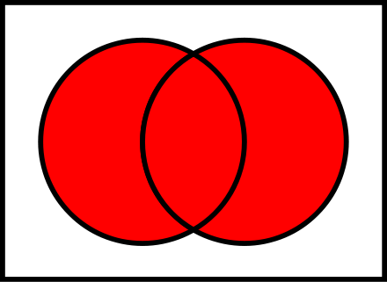

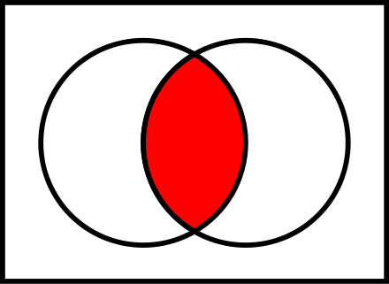
Boolean operations in set theory
In set theory, we have

Slide 11
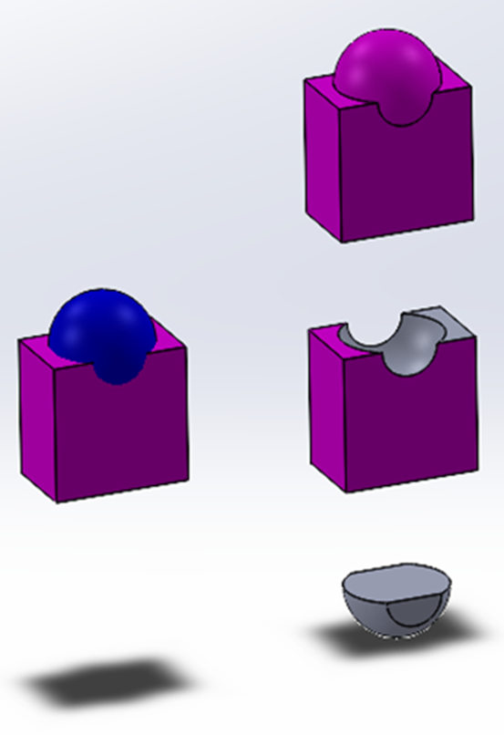
Boolean operations of multi-bodies
Target: The body with the finished geometry is called the target;
Tool: The body used to create or edit the shape is called the tool.

Slide 12
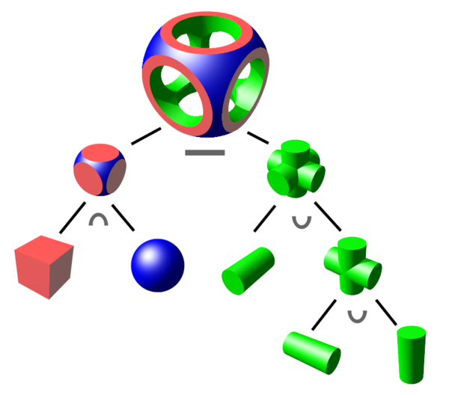
Boolean logic with binary tree
A binary tree structure is usually used to store the basic bodies one lead nodes, the operations on the internal nodes, and the final body on the root node.

Slide 13
CAM

Slide 14
fundamentals of computer communication
manufacturing communication systems
data exchange standards

Slide 15
3D-printing techniques
3D-printing techniques

Slide 16
Fundamentals of NC machine systems
NC part programming and computer aided part programming

Slide 17
CAPP
processing planning systems

Slide 18
Configuration for a mill or turn machine
Features to machining strategy
Generate operation plan
Generate tool path
Simulation
Post process

Slide 19
The following slides are only for learning purpose

Slide 20
Create a new part
Check the unit setting
Using sketch to create part body
Smart dimension is an import tool to drive the model creatation

Slide 21
Go to the Solidworks CAM module(just perform each of tool button alone the toolbar from left to right, one can finally get the tool path and G-codes)
Define machine
Setup coordinate system
Define stock size using stock manager

Slide 22
Using setup->mill setup to tell the machine which direction is the machining (removing material) direction.
Extract machinable features(which features will be removed)
Generate operation plan(usually have cutting times for the same surface)
Adjust the plan by removing part of operations or changing some parameters for cutting
How to decide the basic cutting parameters(F/S):
Cutting and spindle speed calculations

Slide 23
Feed rate calculatons
Ususlly, we have general start conditons, in which
For HSS(high speed steel tool)

Slide 24
For Carbide
Depth of cut is approximately 10% the diameter of the tool, except with face mills:0.005 inch max. (SFPM=surface feet per minute)
Decide roughing

